Slide 1
Internal Load
Out Door T
Solar

Slide 2
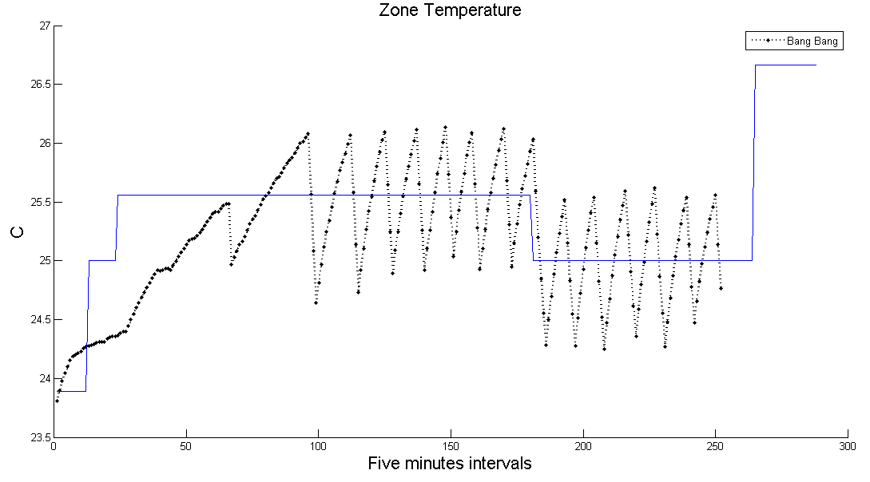
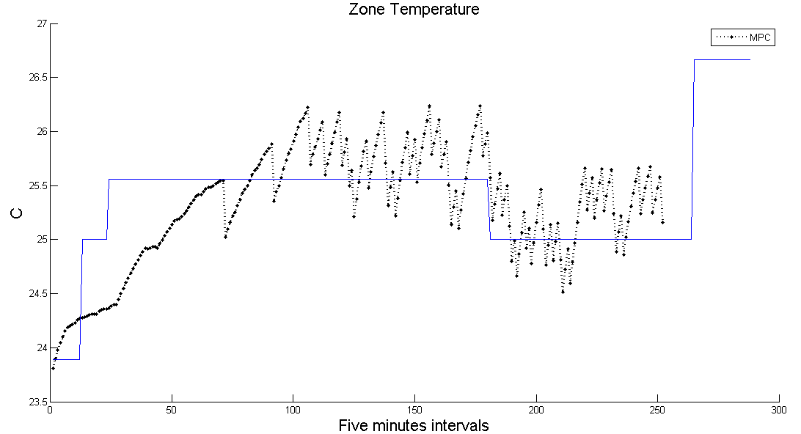

Slide 3
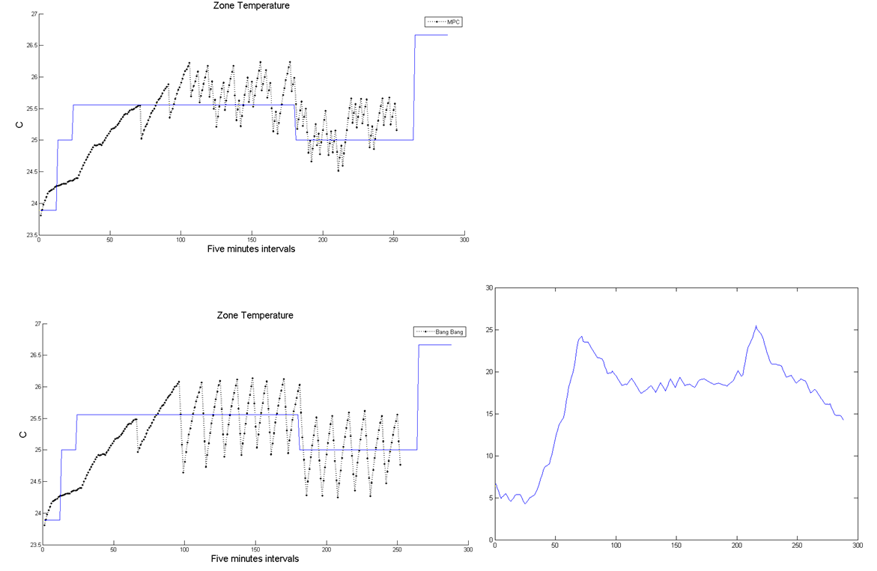
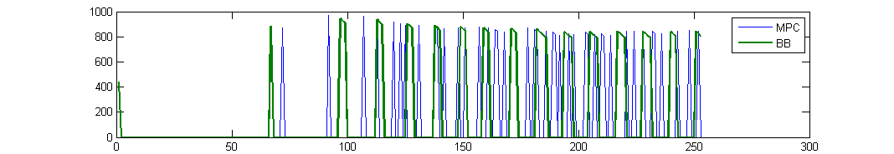
MPC Bill: 1.3838
BB Bill: 1.5443
MPC Ac Power total: 3036 w
BB Ac Power total: 3494 w

Slide 4
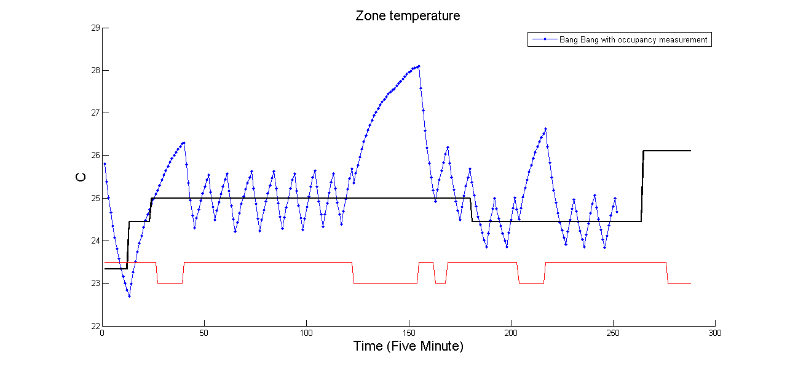
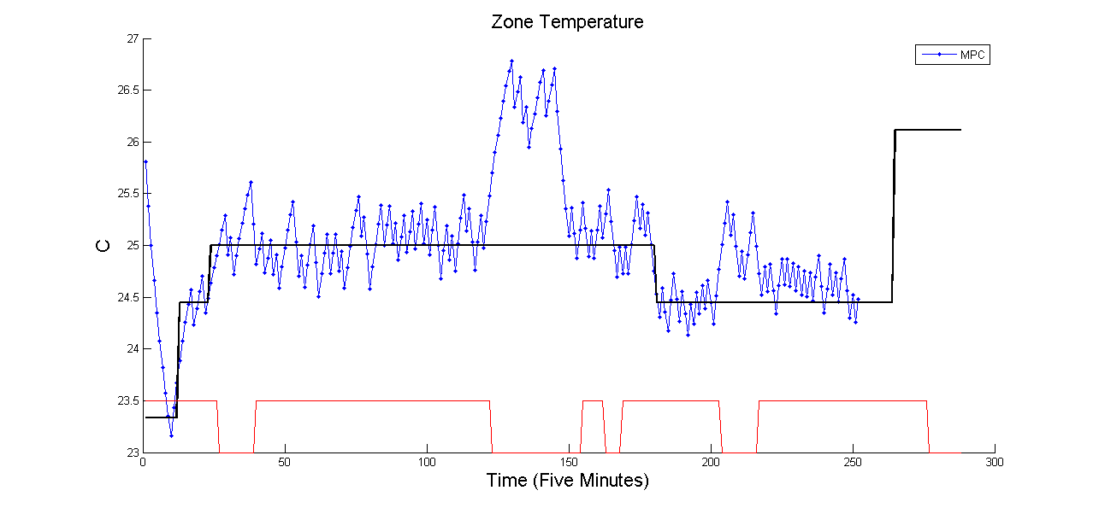

Slide 5
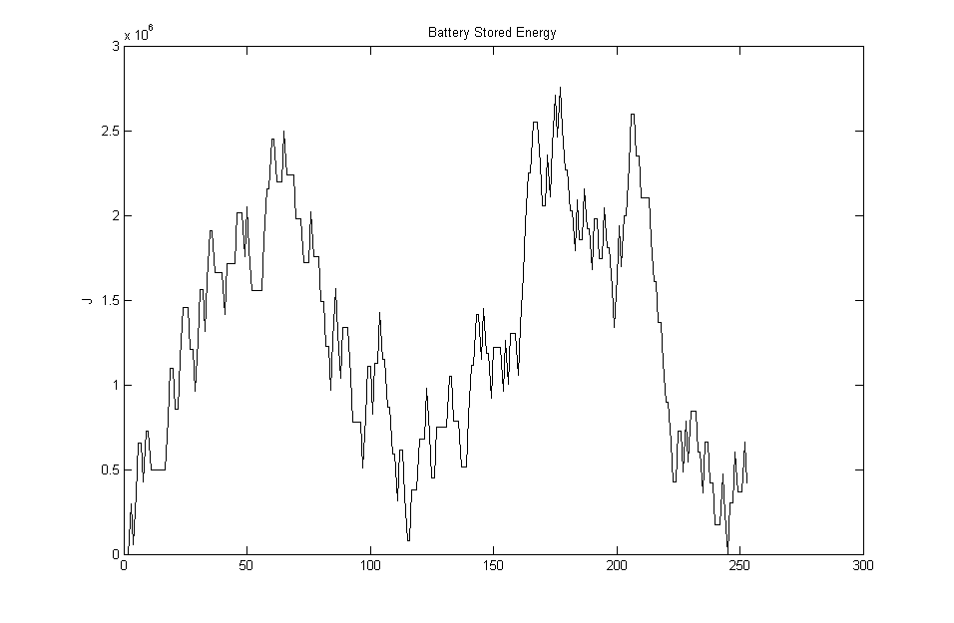
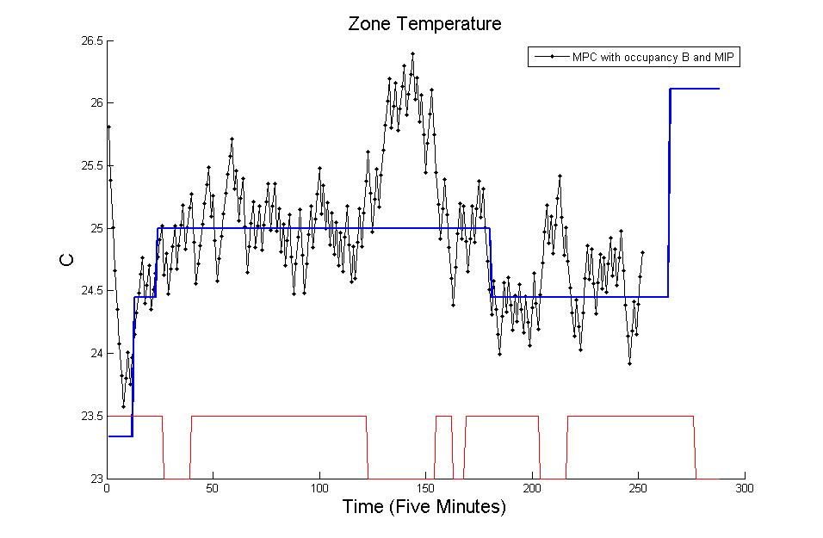
21 Hour test | Occupancy | Battery | AC Power (Wh) | Bill ($)
Bang Bang | ✗ | ✗ | 7882 | 3.27
Bang Bang | ✓ | ✗ | 7116 | 2.95
MPC | ✗ | ✗ | 7667 | 3.21
MPC | ✓ | ✗ | 7536 | 3.11
MPC | ✓ | ✓ | 7488 | 3.13-0.22

